Slide 1
Library Management System (Group 2)
Ahmed Fayez
Abanoub Awad
Shreekrishna ban

Slide 2
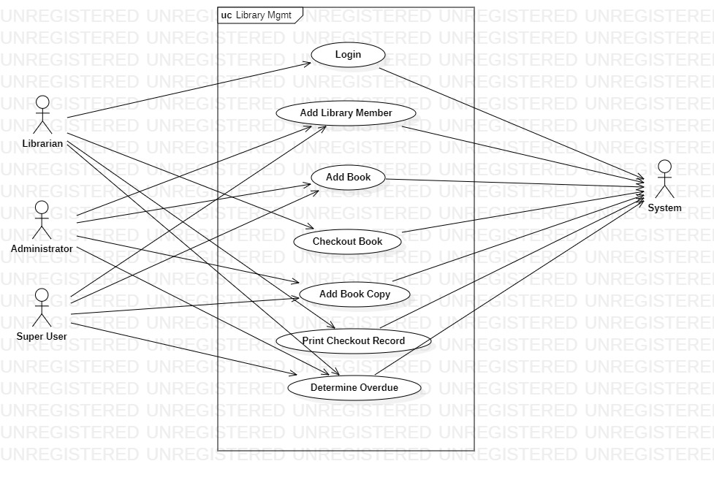
Use Case

Slide 3
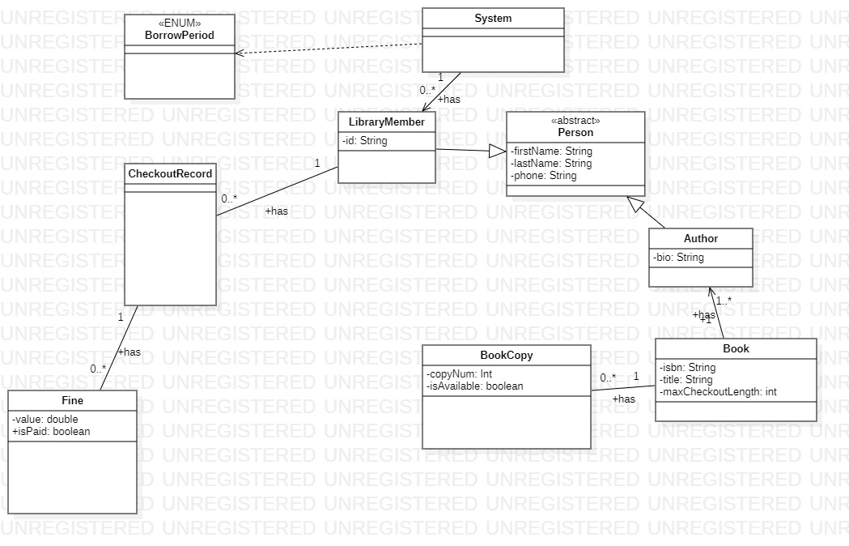
Checkout class diagram

